Slide 1
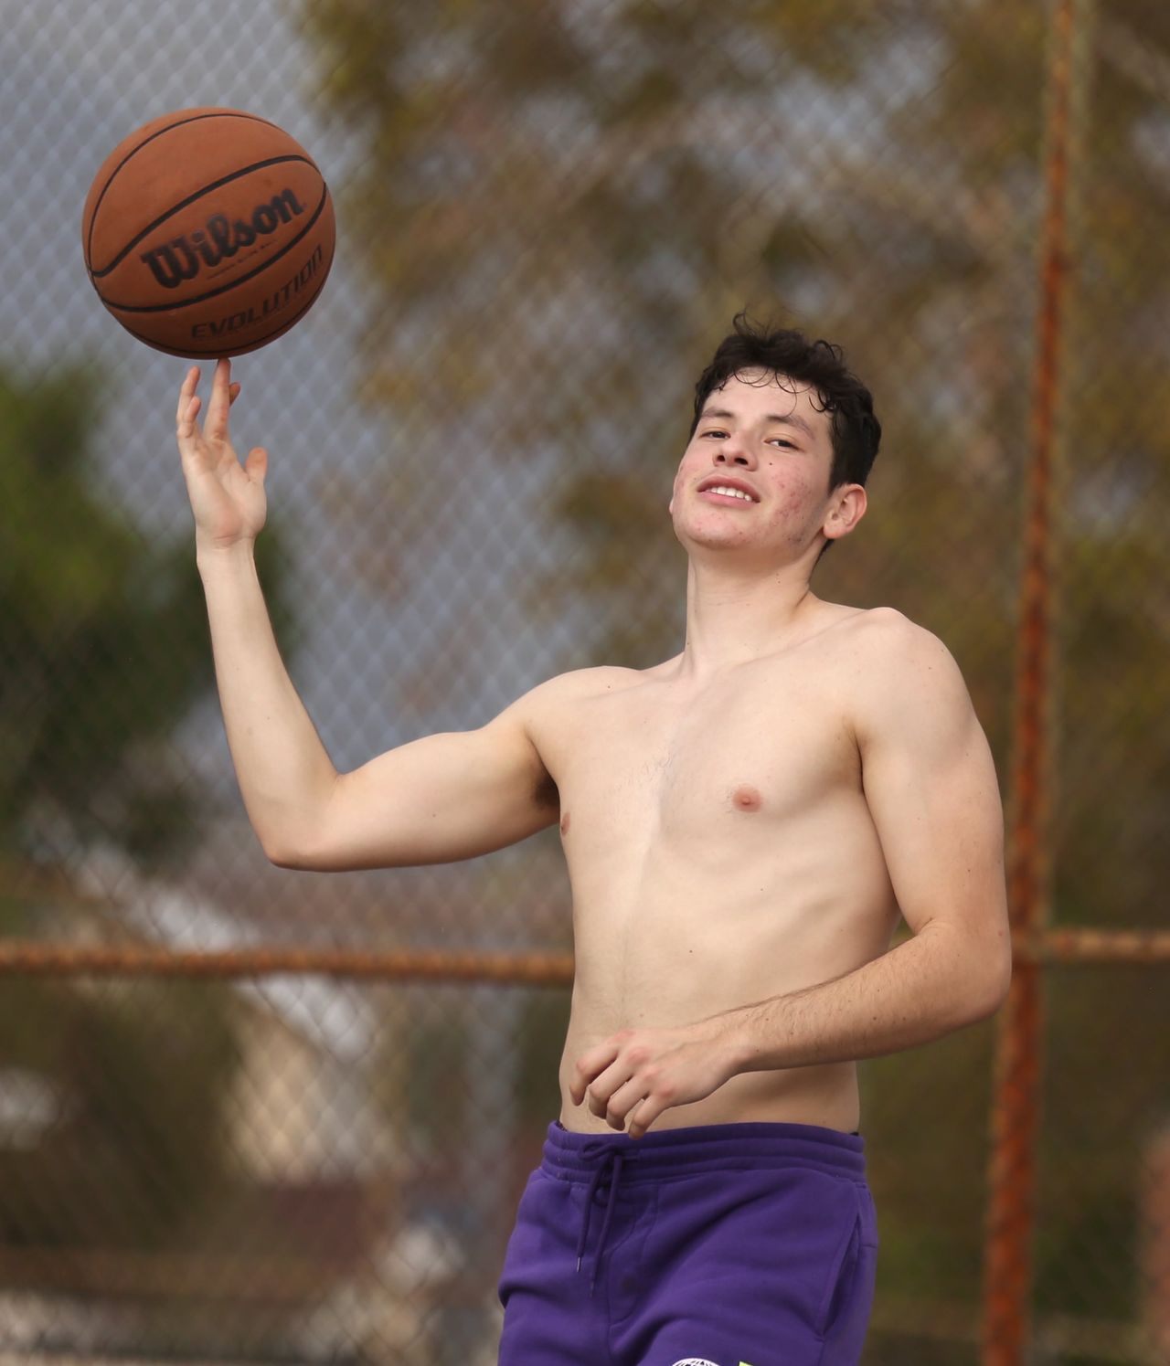
Get
Moving!
Grades 4–6
Together For Health

Slide 2
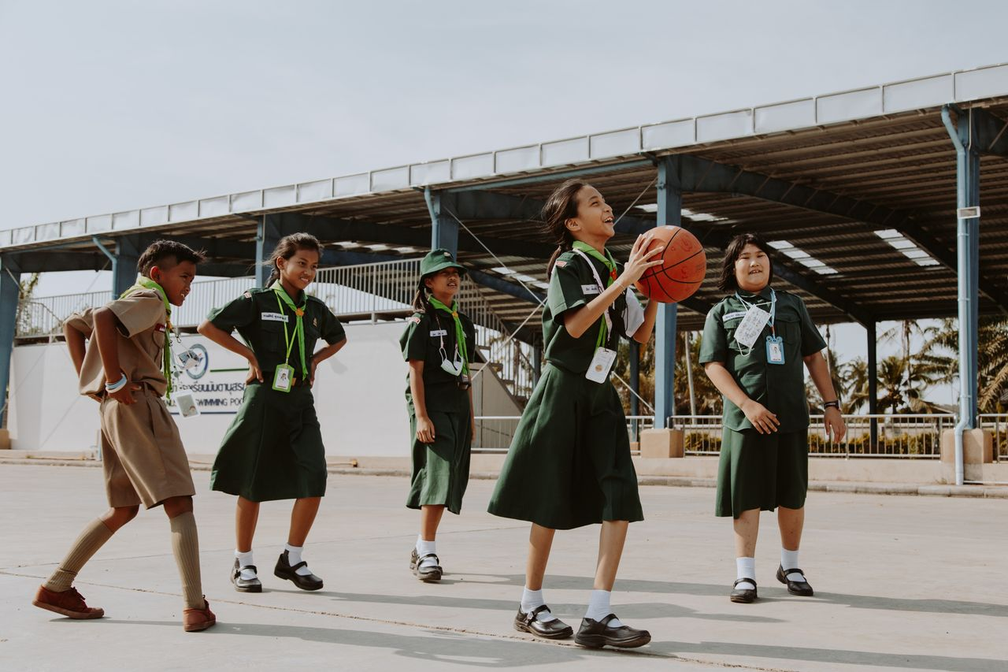
🏃
Movement Is Medicine!
Kids should get at least 60 minutes of physical activity every day.
That does not have to be all at once — it adds up throughout the day.
Together For Health

Slide 3
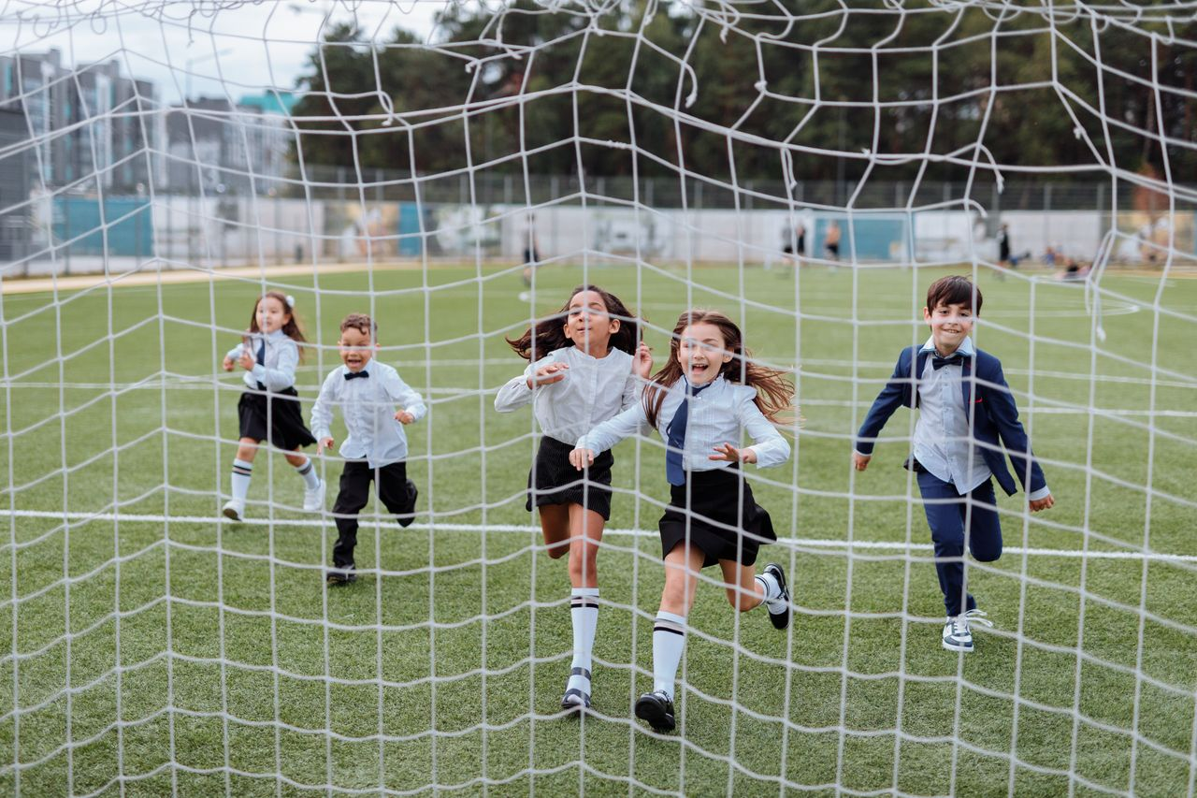
💪
Why Moving Your Body Matters
Makes your heart and lungs stronger
Builds muscles and strong bones
Helps you sleep better
Puts you in a better mood — exercise releases happy chemicals
Helps you focus and do better in school
Together For Health

Slide 4
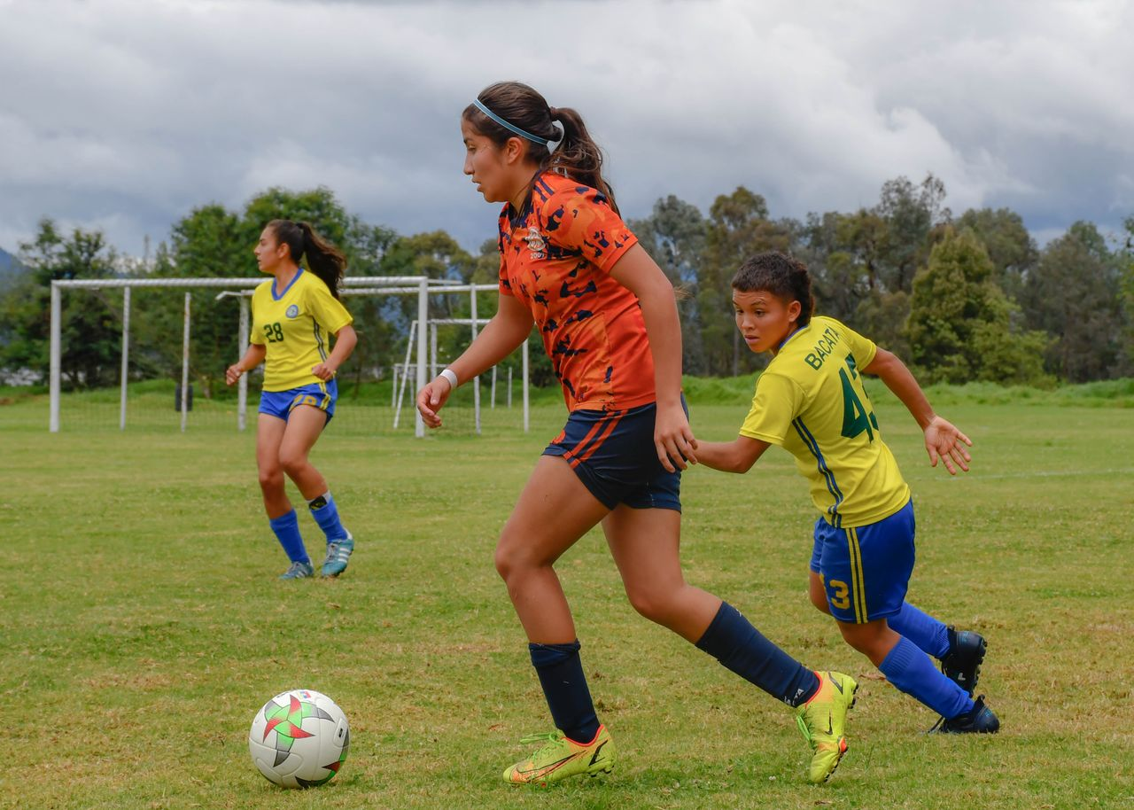
⚡
Ways to Get Moving
Walk or bike to school
Join a sports team or after-school club
Play outside with friends
Dance in your room!
Do chores that involve moving — raking leaves, washing the car
Together For Health

Slide 5
🎯
The 3 Types of Exercise You Need
Cardio: running, swimming, jumping — gets your heart rate up
1
Strength: push-ups, lifting, climbing — builds muscles
2
Flexibility: stretching, yoga — helps you move without getting hurt
3
Together For Health

Slide 6
KEY TAKEAWAYS
Your body was built to move — use it!
✓
60 minutes a day keeps you healthy and happy
✓
Find something you love — it does not feel like exercise then
✓
Resources
ParticipACTION: participaction.com
Try a new sport this month!
Ask your teacher about active recess activities
Together For Health

